Slide 1
Line of Resistance. People of World War II
The Comet Line
Author: Chalapko Egor Vital’evich

Slide 2
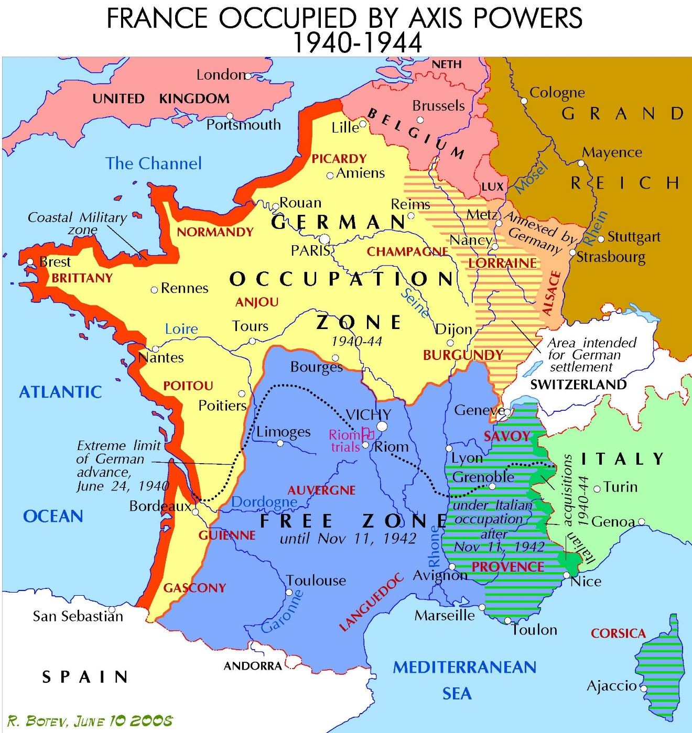
The Comet Line
The Comet Line (1941–1944) was a Resistance organization in occupied Belgium and France in the Second World War. The Comet Line helped Allied soldiers and airmen shot down over occupied Belgium evade capture by Germans and return to Great Britain.

Slide 3

The Comet Line
"Pugna Quin Percutias” -
“Fight Without Arms"

Slide 4
The Comet Line
In three years, the Comet Line helped 776 people, mostly British and American airmen, escape to Spain or evade capture in Belgium and France. An estimated 3,000 civilians, mostly Belgians and French, assisted the Comet Line. They are usually called "helpers." Seven hundred helpers were arrested by the Germans and 290 were executed or died in prison or concentration camps.

Slide 5
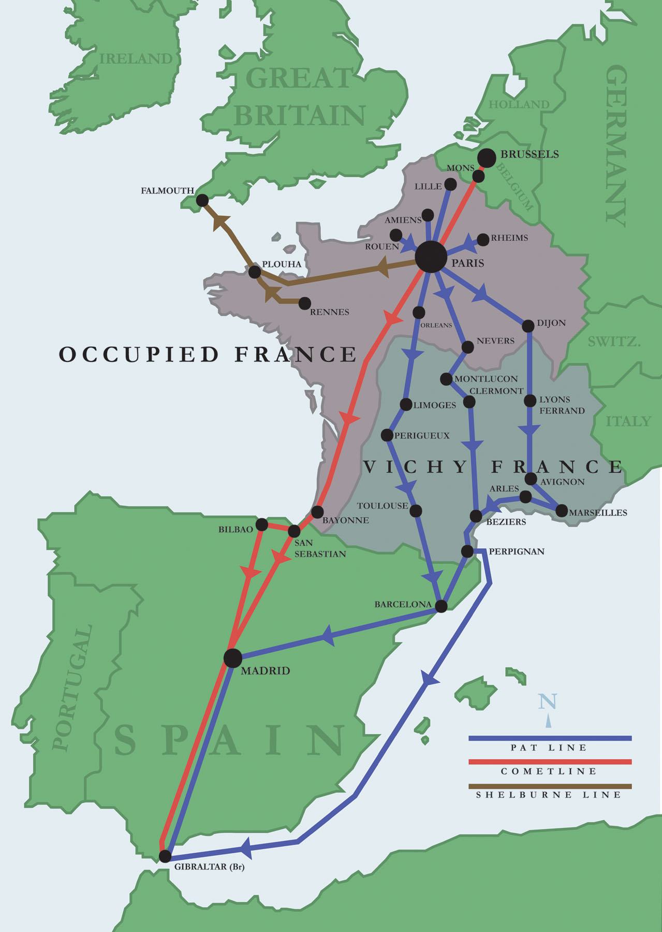
Routes
In three years, the Comet Line helped 776 people, mostly British and American airmen, escape to Spain or evade capture in Belgium and France. An estimated 3,000 civilians, mostly Belgians and French, assisted the Comet Line. They are usually called "helpers." Seven hundred helpers were arrested by the Germans and 290 were executed or died in prison or concentration camps.

Slide 6
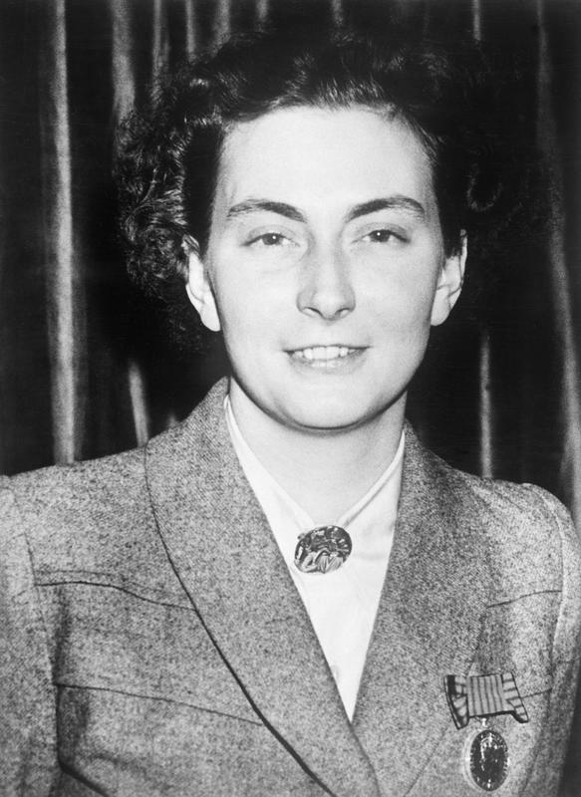
Creation and exploits
The Comet line was created by a young Belgian woman who joined the Belgian Resistance. Andrée de Jongh (nickname "Dédée") was 24 in 1940 and lived in Brussels. She was the younger daughter of Frédéric de Jongh, a headmaster, and Alice Decarpentrie. A heroine of Dédée's in her youth had been Edith Cavell, a British nurse who was shot in 1915 in the Tir National in Schaerbeek for helping troops escape from occupied Belgium to neutral Netherlands.

Slide 7
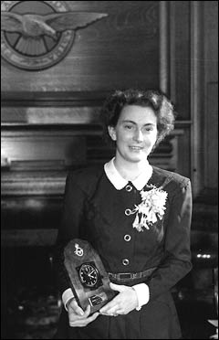
Creation and exploits
Working with MI9 de Jongh helped 400 Allied soldiers escape from Belgium through occupied France to Spain and Gibraltar.
De Jongh escorted 118 airmen over the Pyrenees herself.

Slide 8
Creation and exploits
Many members of the Comet line were betrayed; hundreds were arrested by the Geheime Feldpolizei and the Abwehr and, after weeks of interrogation and torture at places such as Fresnes Prison in Paris, were executed or labelled Nacht und Nebel (NN) prisoners. NN prisoners were deported to German prisons and many later to concentration camps such as Ravensbrück concentration camp for women, Mauthausen-Gusen concentration camp, Buchenwald concentration camp, Flossenbürg concentration camp. Prisoners sent to these camps included Andrée de Jongh, Elsie Maréchal (Belgian Resistance), Nadine Dumon (Belgian Resistance), Mary Lindell (Comtesse de Milleville) and Virginia d'Albert-Lake (American).

Slide 9
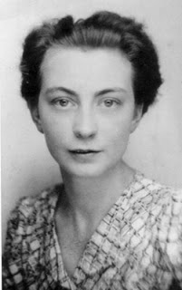
Notable members of the Line
Andrée de Jongh

Slide 10
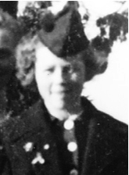
Notable members of the Line
Monique de Bissy

Slide 11
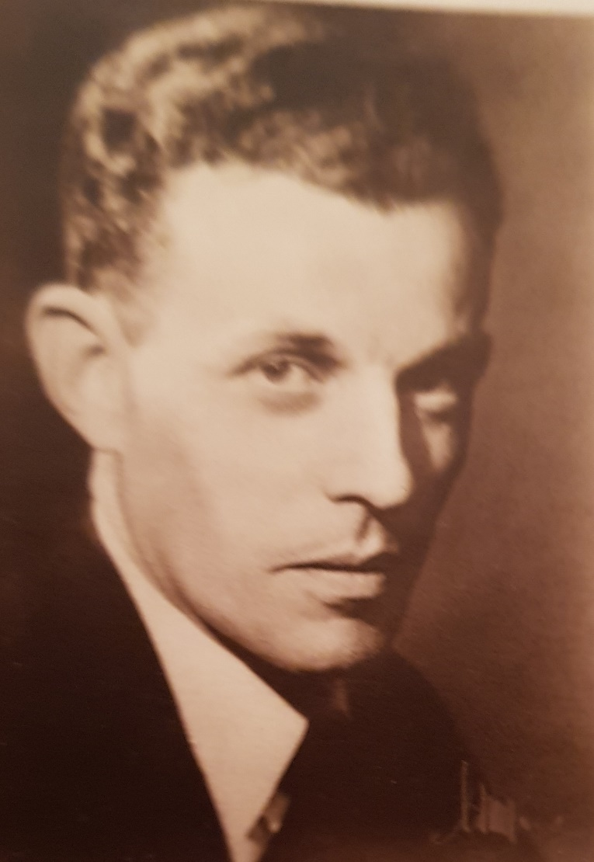
Notable members of the Line
Baron Jean Greindl

Slide 12
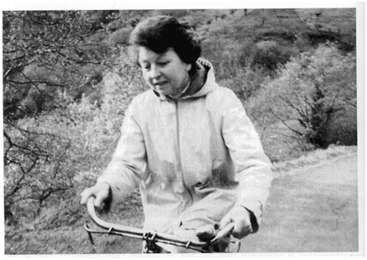
Notable members of the Line
Elvire de Greef

Slide 13
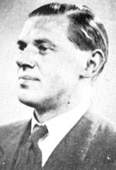
Notable members of the Line
Comte Jacques Legrelle

Slide 14
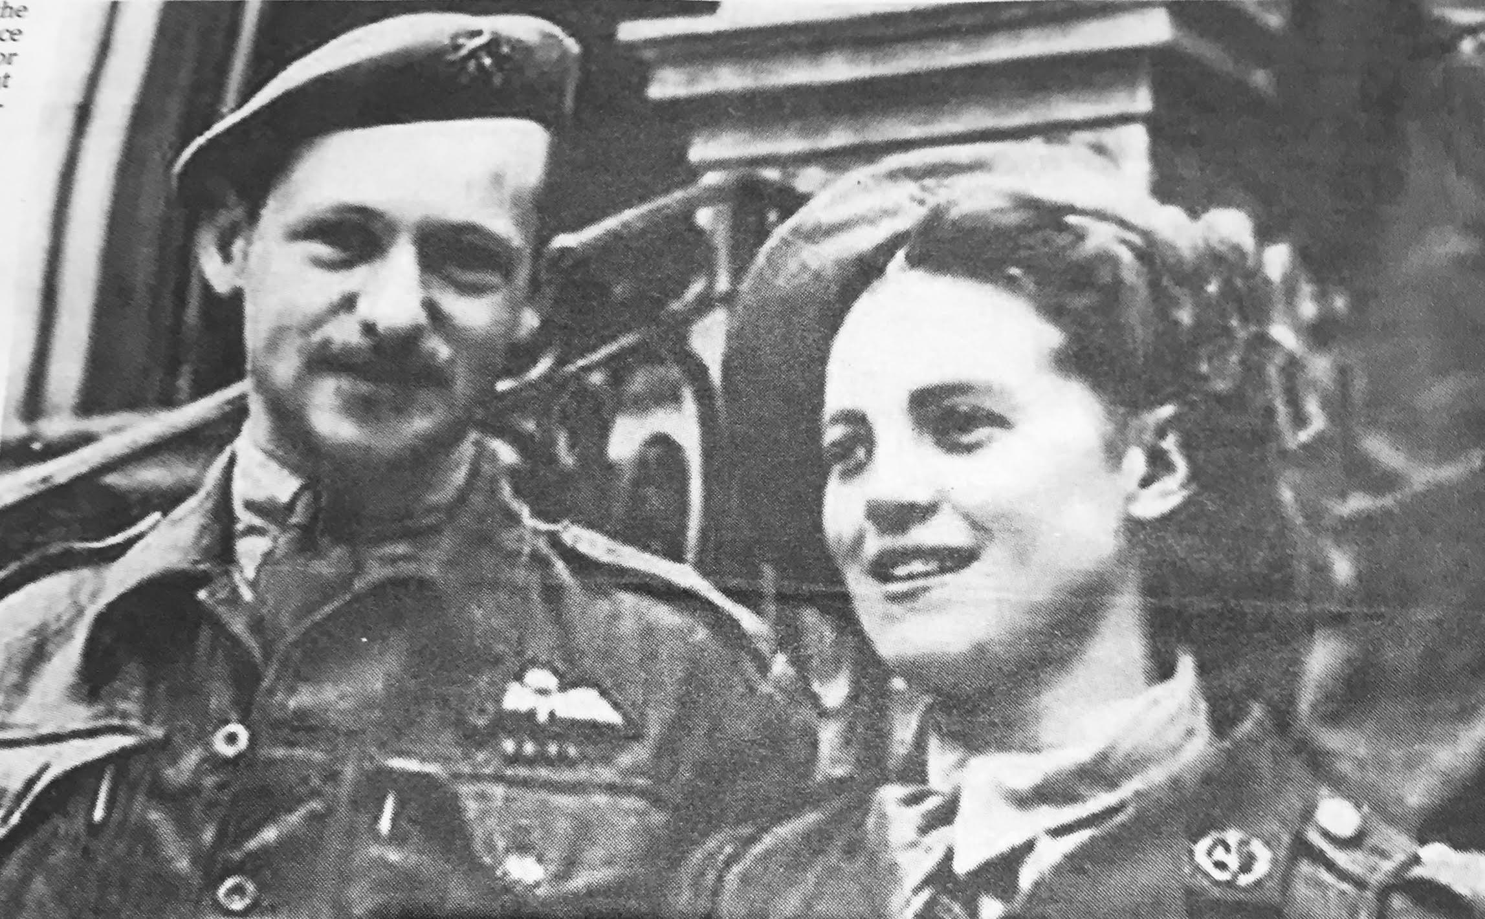
Notable members of the Line
Micheline Dumon

Slide 15
That’s all, folks! Thanks for your attention!

